Slide 1
Chapter 21
Confidence Intervals
Lecture Slides

Slide 2

Case Study: What Is a Confidence Interval? 1
According to the Centers for Disease Control and Prevention (CDC), adults who engage in less than 30 minutes of moderate physical exercise per day should consume one and a half to two cups of fruits per day and two to three cups of vegetables per day. Are adults meeting these recommendations?

Slide 3
Case Study: What Is a Confidence Interval? 2
The Behavioral Risk Factor Surveillance System (BRFSS) is an ongoing, state-based, random digit-dialed telephone survey of adults who are at least 18 years of age.
The BRFSS is the world’s largest ongoing telephone health survey system.
Data are gathered monthly from all 50 states, the District of Columbia (DC), Puerto Rico, the U.S. Virgin Islands, and Guam.

Slide 4
Case Study: What Is a Confidence Interval? 3
Survey respondents were asked to think about the previous month and to indicate how many times per day, week, or month they consumed whole fruit, 100% fruit juice, dried beans, dark green vegetables, orange vegetables, and other vegetables.
Although close to 500,000 individuals were originally contacted to be a part of the survey in 2013, 118,193 respondents were excluded from analysis because they either resided in other countries, had missing responses to one or more questions, or had implausible reports of fruit and vegetable consumption.

Slide 5
Case Study: What Is a Confidence Interval? 4
The results reported in the 2013 BRFSS are based on the final sample of 373,580 adults.
Across the states, results varied. The state with the largest number of survey respondents reporting meeting the daily fruit and vegetable intake recommendations was California.
17.7% of the 9,011 California residents who were surveyed met the daily fruit intake recommendations and 13% met the daily vegetable intake recommendations.

Slide 6
Case Study: What Is a Confidence Interval? 5
We know these numbers won’t be exactly right for the entire population of adults in California, but are they close?
In this chapter, we study confidence intervals.
These are intervals that help us see how accurate numbers such as 17.7% and 13% are.
By the end of this chapter, you will be able to construct such intervals for proportions and means, and you will be able to interpret what such intervals represent.

Slide 7
Estimating 1
Statistical inference draws conclusions about a population on the basis of data about a sample.
One kind of conclusion answers questions such as, “What percent of employed women have a college degree?’’ or “What is the mean survival time for patients with this type of cancer?’’
Numbers that describe a population are parameters. To estimate a population parameter, choose a sample from the population and use a statistic, a number calculated from the sample, as your estimate.

Slide 8
Example: Graduation Plans 1
The National Survey of Student Engagement (NSSE) is administered annually to first-year and senior undergraduate students across the United States and Canada.
In 2018, the NSSE was completed by students from 511 institutions of higher learning. One question graduating seniors were asked was, “After graduation, what best describes your immediate plans?”

Slide 9
Example: Graduation Plans 2
Of the 23,915 seniors who answered this question, 5,038 indicated they planned to go to graduate or professional school.
Based on this information, what can we say about the percentage of all college seniors who plan to go to graduate or professional school?
The population is college seniors who reside in the United States or Canada.
The parameter is the proportion who plan to go to graduate or professional school.

Slide 10
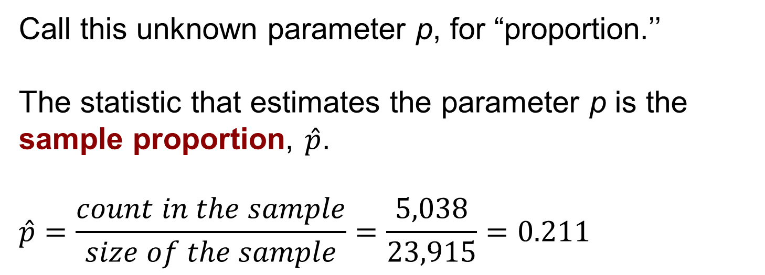
Example: Graduation Plans 3
Call this unknown parameter p, for “proportion.’’
The statistic that estimates the parameter p is the sample proportion, $\hat{p}$.
$$\hat{p}=\frac{count in the sample}{size of the sample}=\frac{5,038}{23,915}=0.211$$

Slide 11
Estimating 2
It makes sense to use the sample to estimate that the proportion of all college seniors who plan to go to graduate or professional school is “about 21.1%’’ because the proportion in the sample was 21.1%.
We can only estimate that the truth about the population is “about’’ 21.1% because we know that the sample result is unlikely to be exactly the same as the true population proportion.

Slide 12
Estimating 3
A confidence interval makes that “about’’ precise.
A 95% confidence interval is an interval calculated from sample data by a process that is guaranteed to capture the true population parameter in 95% of all samples.

Slide 13
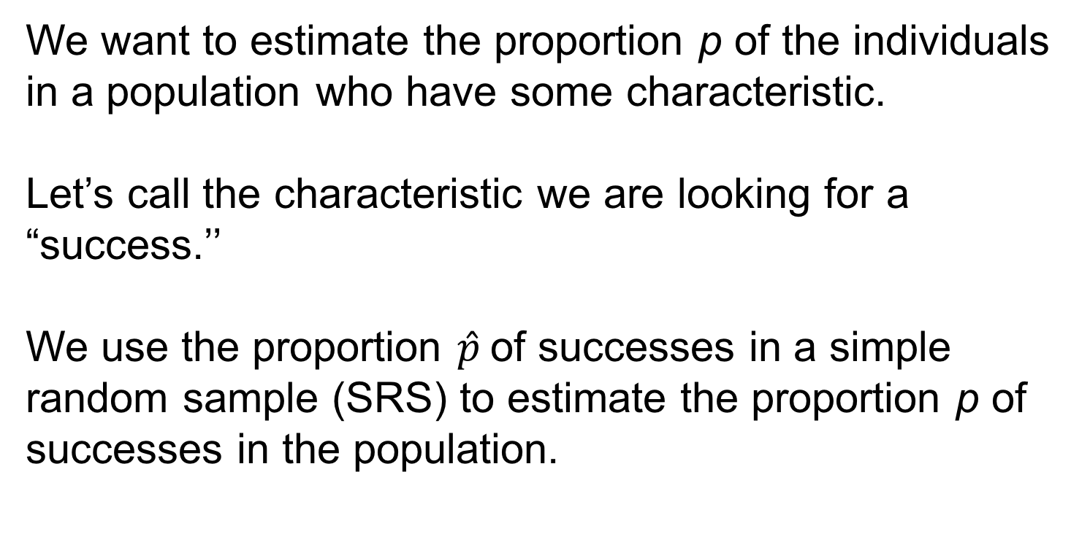
Estimating with Confidence 1
We want to estimate the proportion p of the individuals in a population who have some characteristic.
Let’s call the characteristic we are looking for a “success.’’
We use the proportion $\hat{p}$of successes in a simple random sample (SRS) to estimate the proportion p of successes in the population.

Slide 14
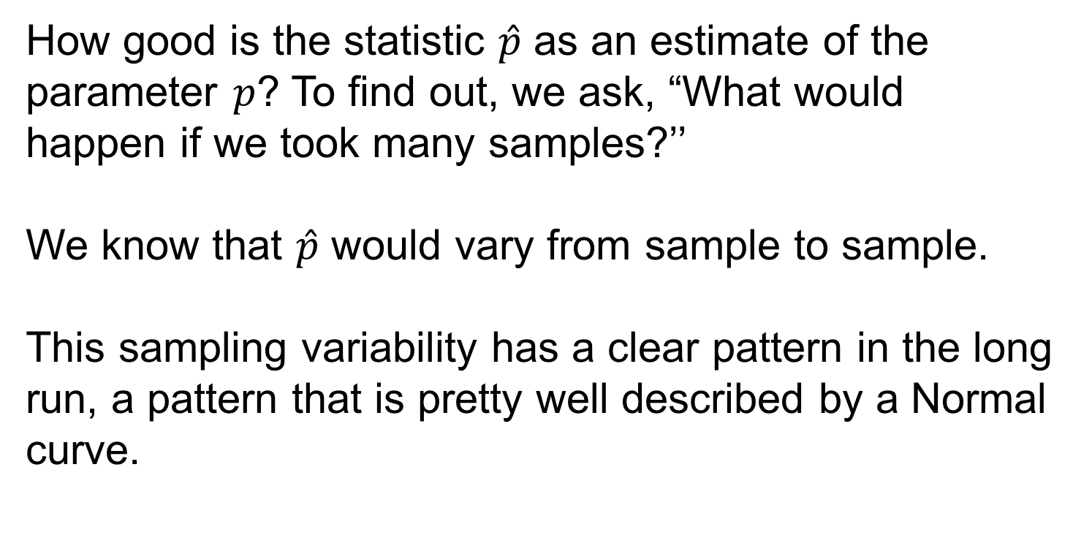
Estimating with Confidence 2
How good is the statistic $\hat{p}$ as an estimate of the parameter $p$? To find out, we ask, “What would happen if we took many samples?’’
We know that $\hat{p}$ would vary from sample to sample.
This sampling variability has a clear pattern in the long run, a pattern that is pretty well described by a Normal curve.

Slide 15
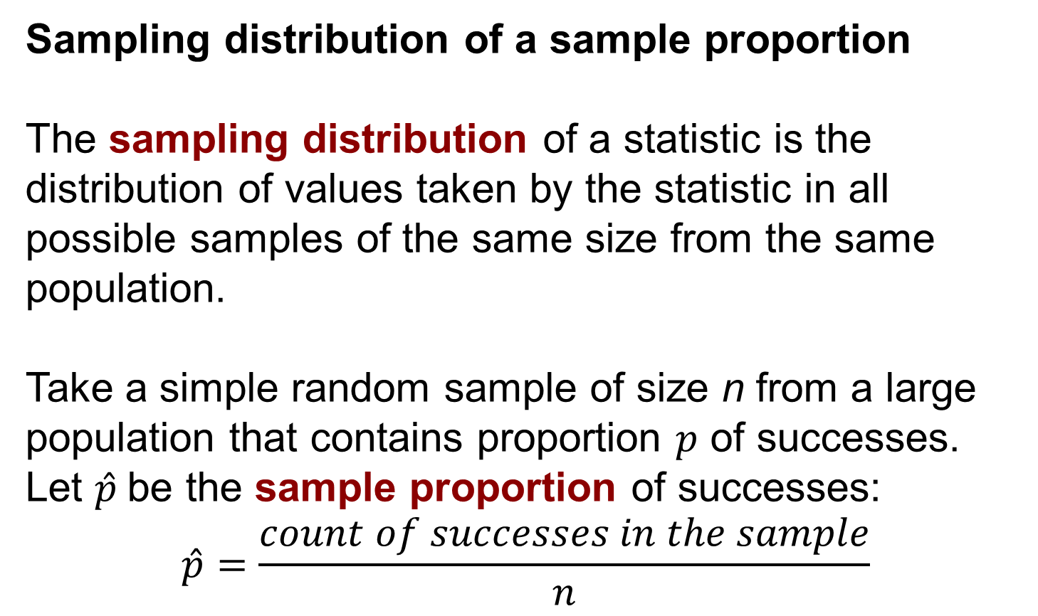
Estimating with Confidence 3
Sampling distribution of a sample proportion
The sampling distribution of a statistic is the distribution of values taken by the statistic in all possible samples of the same size from the same population.
Take a simple random sample of size n from a large population that contains proportion $p$ of successes. Let $\hat{p}$be the sample proportion of successes:
$$\hat{p}=\frac{count of successes in the sample}{n}$$

Slide 16
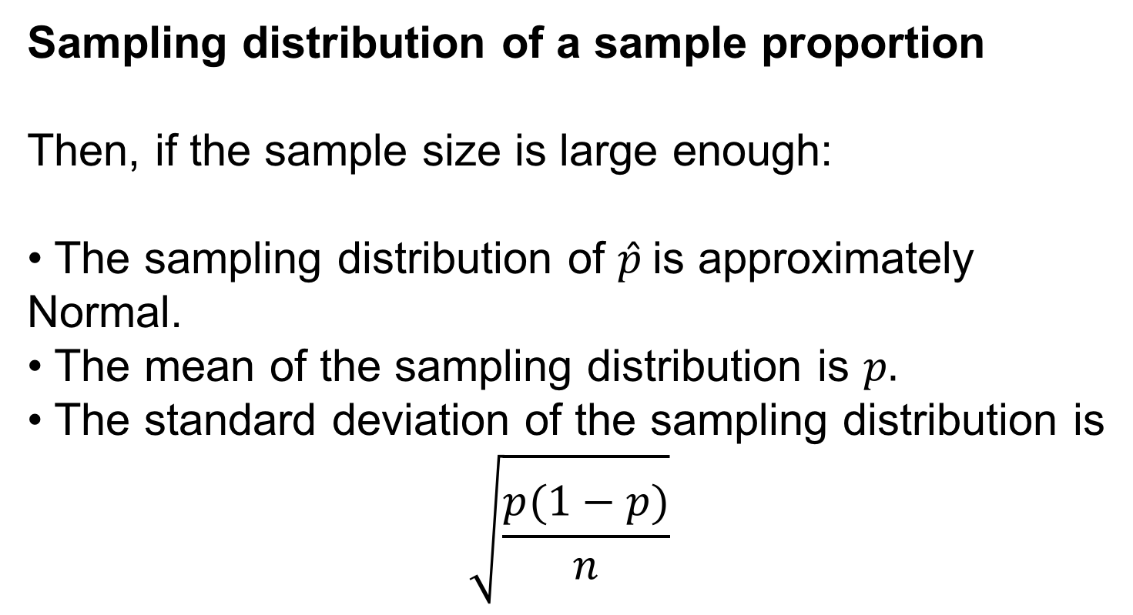
Estimating with Confidence 4
Sampling distribution of a sample proportion
Then, if the sample size is large enough:
• The sampling distribution of $\hat{p}$is approximately Normal.
• The mean of the sampling distribution is $p.$
• The standard deviation of the sampling distribution is
$$\sqrt{\frac{p(1−p)}{n}}$$

Slide 17
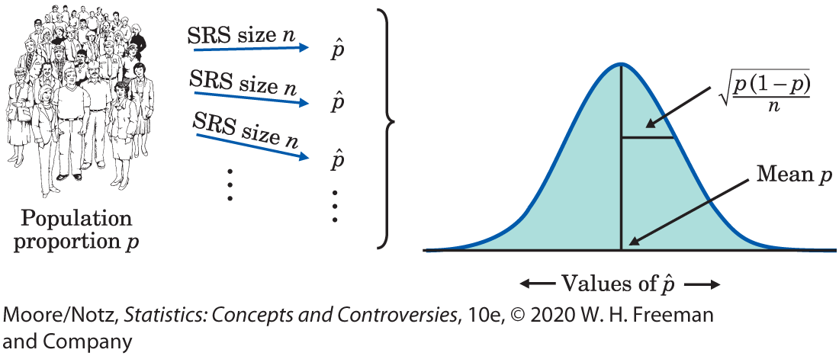
Estimating with Confidence 5
Sampling Distribution of a Sample Proportion

Slide 18
Estimating with Confidence 6
The standard deviation of the sampling distribution of a sample statistic is commonly referred to as the standard error.

Slide 19
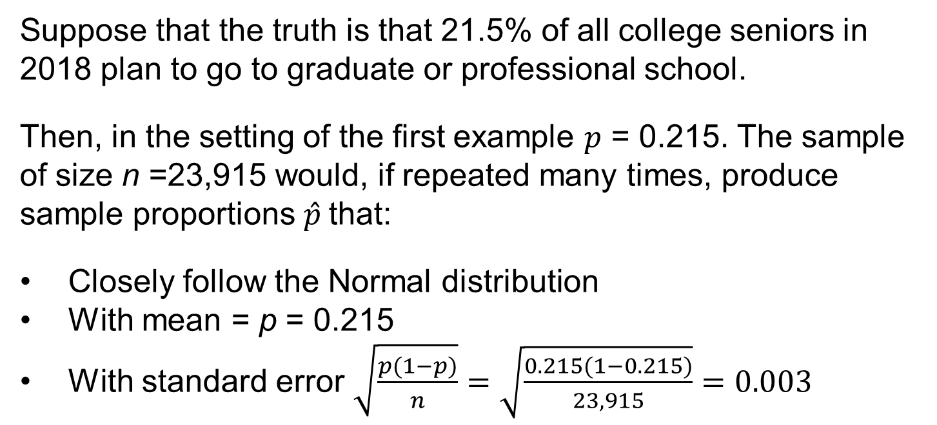
Example: More on Graduation Plans
Suppose that the truth is that 21.5% of all college seniors in 2018 plan to go to graduate or professional school.
Then, in the setting of the first example $p$ = 0.215. The sample of size n =23,915 would, if repeated many times, produce sample proportions $\hat{p}$that:
Closely follow the Normal distribution
With mean = p = 0.215
With standard error $\sqrt{\frac{p(1−p)}{n}}=\sqrt{\frac{0.215(1−0.215)}{23,915}}=0.003$

Slide 20
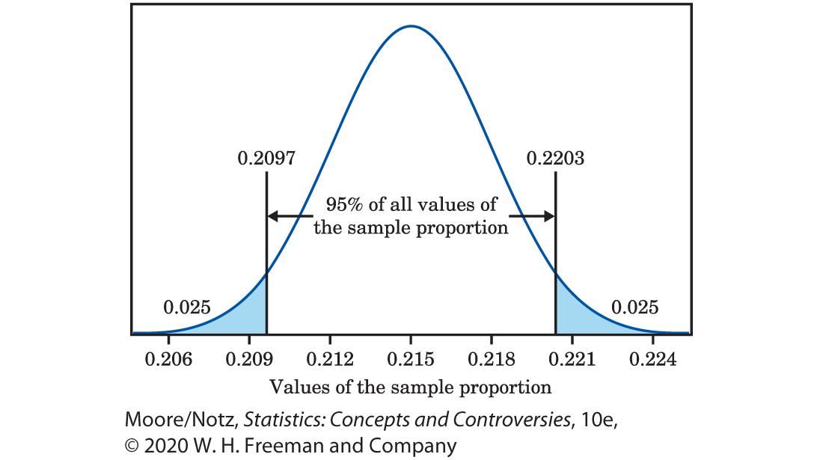
Example: More on Graduation Plans (continued)

Slide 21
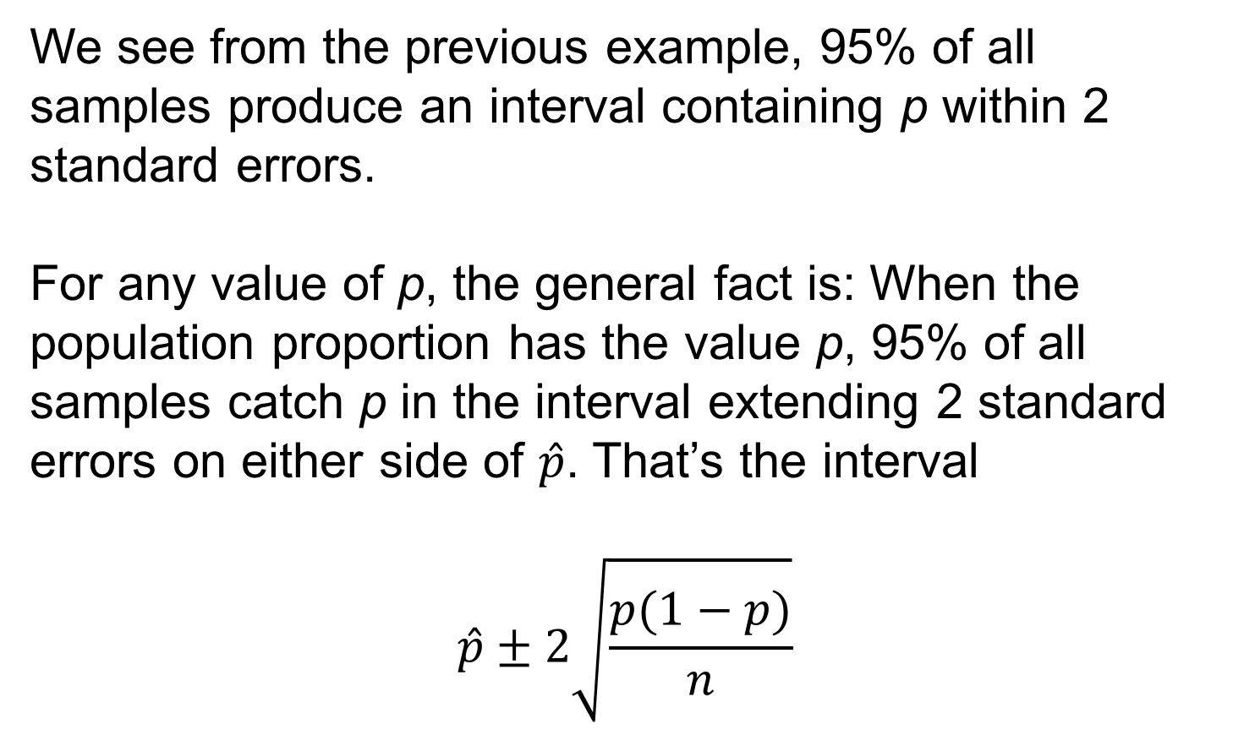
Estimating with Confidence 7
We see from the previous example, 95% of all samples produce an interval containing p within 2 standard errors.
For any value of p, the general fact is: When the population proportion has the value p, 95% of all samples catch p in the interval extending 2 standard errors on either side of $\hat{p}$. That’s the interval
$$\hat{p}±2\sqrt{\frac{p(1−p)}{n}}$$

Slide 22
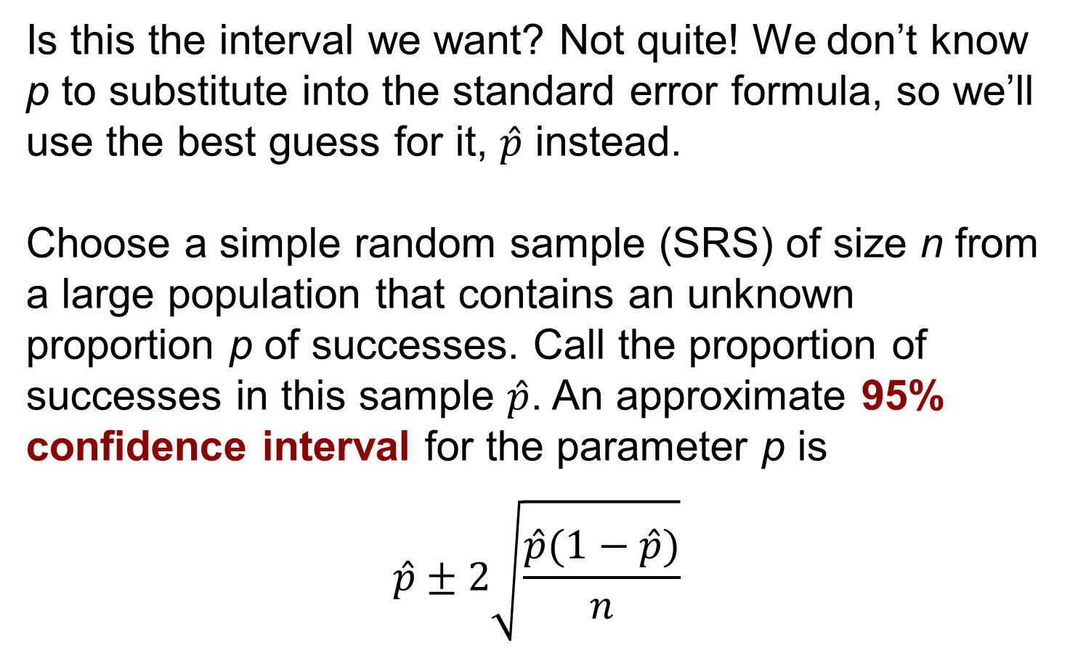
Estimating with Confidence 8
Is this the interval we want? Not quite! We don’t know p to substitute into the standard error formula, so we’ll use the best guess for it, $\hat{p}$ instead.
Choose a simple random sample (SRS) of size n from a large population that contains an unknown proportion p of successes. Call the proportion of successes in this sample $\hat{p}$. An approximate 95% confidence interval for the parameter p is
$$\hat{p}±2\sqrt{\frac{\hat{p}(1−\hat{p})}{n}}$$

Slide 23
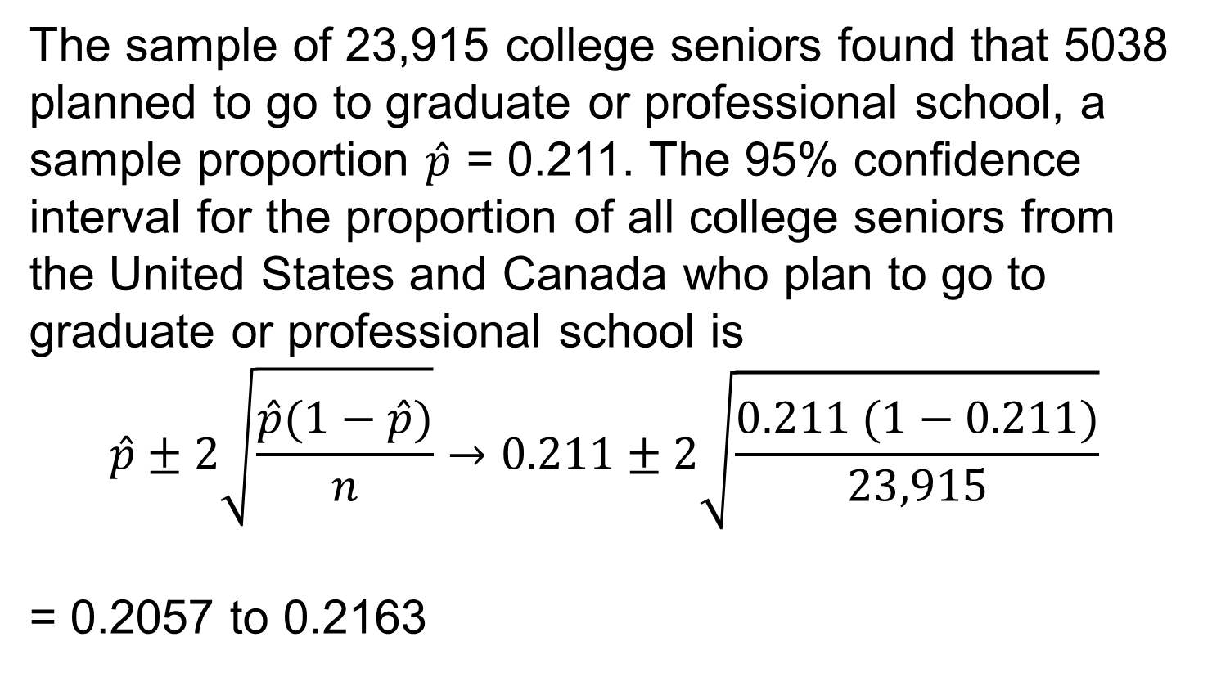
Example: A Confidence Interval for Graduation Plans
The sample of 23,915 college seniors found that 5038 planned to go to graduate or professional school, a sample proportion $\hat{p}$ = 0.211. The 95% confidence interval for the proportion of all college seniors from the United States and Canada who plan to go to graduate or professional school is
$$\hat{p}±2\sqrt{\frac{\hat{p}(1−\hat{p})}{n}}→0.211±2\sqrt{\frac{0.211 (1−0.211)}{23,915}}$$
= 0.2057 to 0.2163

Slide 24
Example: A Confidence Interval for Graduation Plans (continued)
Interpret this result as follows: We got this interval by using a recipe that catches the true unknown population proportion in 95% of all samples.
The shorthand is that we are 95% confident that between 20.57% and 21.63% of all college seniors in the United States and Canada plan to go to graduate or professional school.

Slide 25
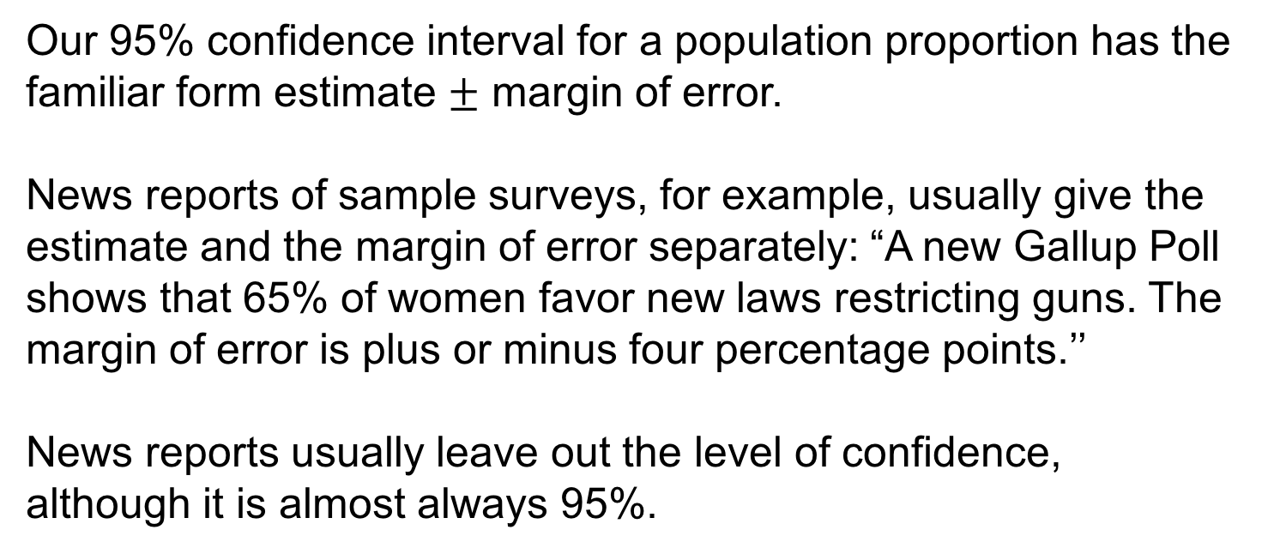
Understanding Confidence Intervals 1
Our 95% confidence interval for a population proportion has the familiar form estimate $±$ margin of error.
News reports of sample surveys, for example, usually give the estimate and the margin of error separately: “A new Gallup Poll shows that 65% of women favor new laws restricting guns. The margin of error is plus or minus four percentage points.’’
News reports usually leave out the level of confidence, although it is almost always 95%.

Slide 26
Understanding Confidence Intervals 2
The next time you hear a report about the result of a sample survey, consider the following.
If most confidence intervals reported in the media have a 95% level of confidence, then in about 1 in 20 poll results that you hear about, the confidence interval does not contain the true proportion.

Slide 27
Understanding Confidence Intervals 3
A level C confidence interval for a parameter has two parts:
• An interval calculated from the data.
• A confidence level C, which gives the probability that the interval will capture the true parameter value in repeated samples.
Confidence intervals use the central idea of probability: ask what would happen if we repeated the sampling many times. The 95% in a 95% confidence interval is a probability, the probability that the method produces an interval that does capture the true parameter.

Slide 28
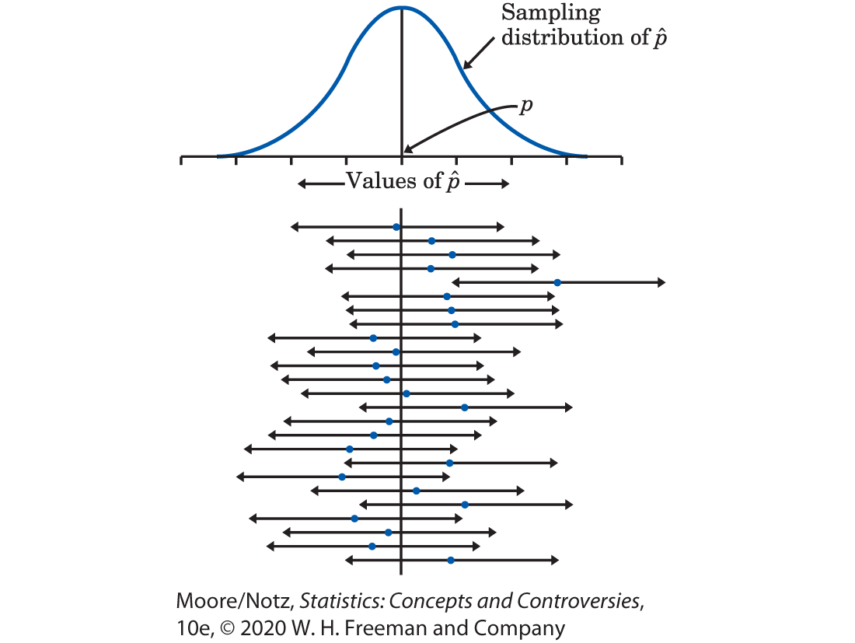
Understanding Confidence Intervals 4

Slide 29
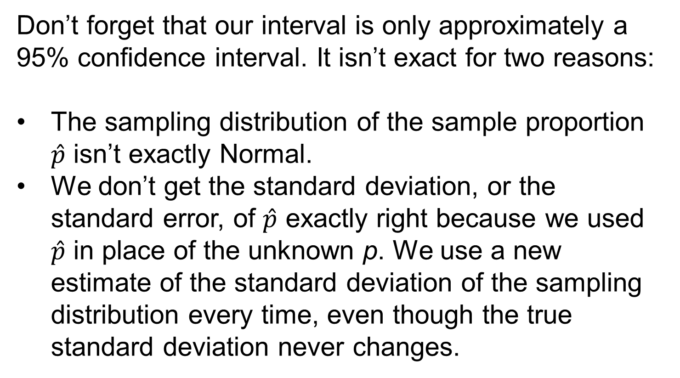
Understanding Confidence Intervals 5
Don’t forget that our interval is only approximately a 95% confidence interval. It isn’t exact for two reasons:
The sampling distribution of the sample proportion $\hat{p}$ isn’t exactly Normal.
We don’t get the standard deviation, or the standard error, of $\hat{p}$ exactly right because we used $\hat{p}$ in place of the unknown p. We use a new estimate of the standard deviation of the sampling distribution every time, even though the true standard deviation never changes.

Slide 30
Understanding Confidence Intervals 6
Both of these difficulties go away as the sample size n gets larger. So, our recipe is good only for large samples.
What is more, the recipe assumes that the population is really big—at least 10 times the size of the sample.
Professional statisticians use more elaborate methods that take the size of the population into account and work even for small samples. But our method works well enough for many practical uses.

Slide 31
More on Confidence Intervals for a Population Proportion (optional) 1
We used the 95 part of the 68–95–99.7 rule to get a 95% confidence interval for the population proportion.
Suppose you want to be 99% confident. For that, we need to mark off the central 99% of a Normal distribution.
For any probability C between 0 and 1, there is a number z* such that any Normal distribution has probability C within z* standard deviations of the mean.

Slide 32
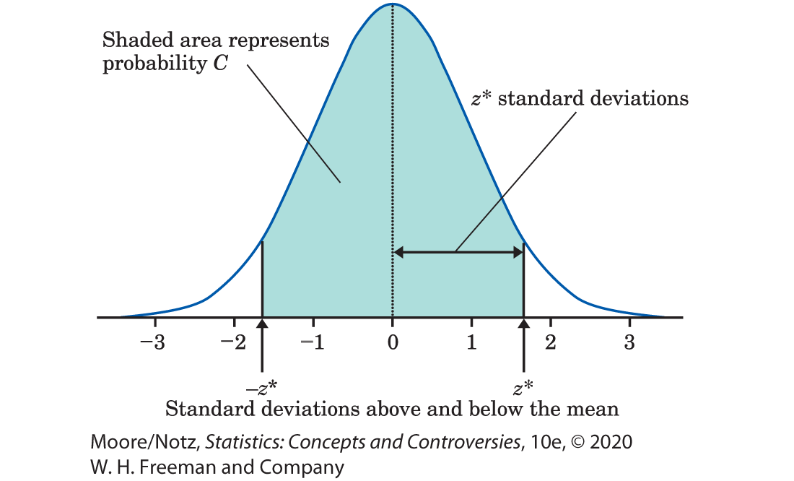
More on Confidence Intervals for a Population Proportion (optional) 2

Slide 33
More on Confidence Intervals for a Population Proportion (optional) 3
Table 21.1 gives the numbers z* for various choices of C. For convenience, the table gives C as a confidence level in percent. The numbers z* are called critical values of the Normal distributions.
Confidence Level C | Critical value z*
50% | 0.67
60% | 0.84
70% | 1.04
80% | 1.28
Confidence Level C | Critical value z*
90 | 1.64
95% | 1.96
99% | 2.58
99.9% | 3.29

Slide 34
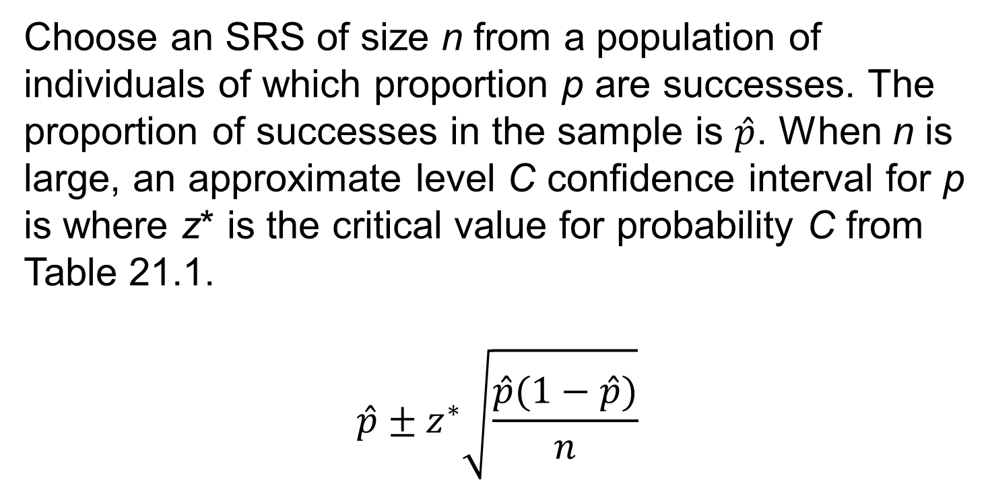
More on Confidence Intervals for a Population Proportion (optional) 4
Choose an SRS of size n from a population of individuals of which proportion p are successes. The proportion of successes in the sample is $\hat{p}$. When n is large, an approximate level C confidence interval for p is where z* is the critical value for probability C from Table 21.1.
$$\hat{p}±z^{∗}\sqrt{\frac{\hat{p}(1−\hat{p})}{n}}$$

Slide 35
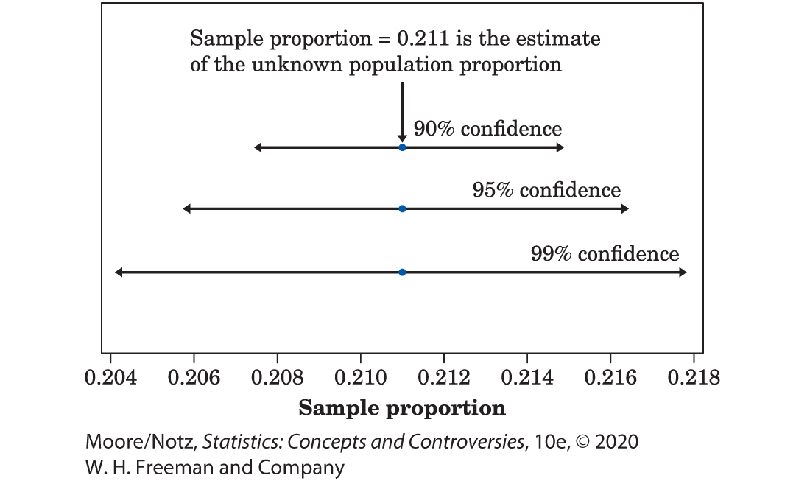
More on Confidence Intervals for a Population Proportion (optional) 5
Using the same sample, a confidence interval will be wider when using a higher level of confidence.

Slide 36
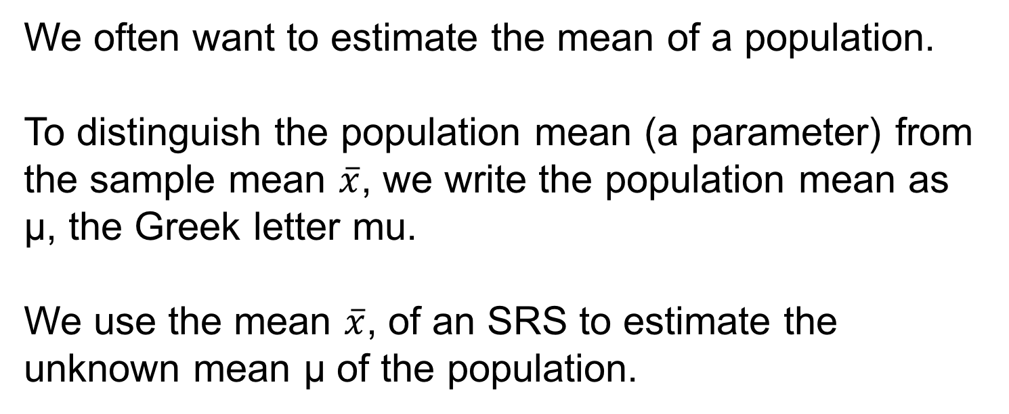
The Sampling Distribution of a Sample Mean (optional) 1
We often want to estimate the mean of a population.
To distinguish the population mean (a parameter) from the sample mean $\overline{x}$, we write the population mean as µ, the Greek letter mu.
We use the mean $\overline{x}$, of an SRS to estimate the unknown mean µ of the population.

Slide 37
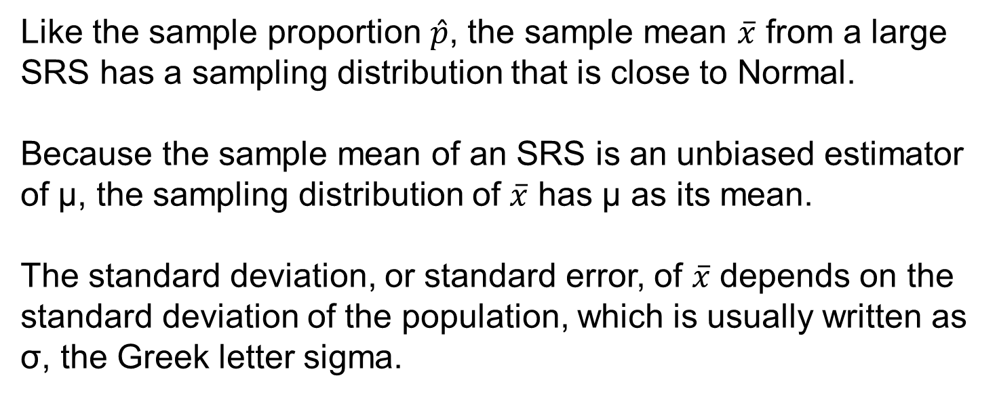
The Sampling Distribution of a Sample Mean (optional) 2
Like the sample proportion $\hat{p}$, the sample mean $\overline{x}$ from a large SRS has a sampling distribution that is close to Normal.
Because the sample mean of an SRS is an unbiased estimator of µ, the sampling distribution of $\overline{x}$ has µ as its mean.
The standard deviation, or standard error, of $\overline{x}$ depends on the standard deviation of the population, which is usually written as σ, the Greek letter sigma.

Slide 38
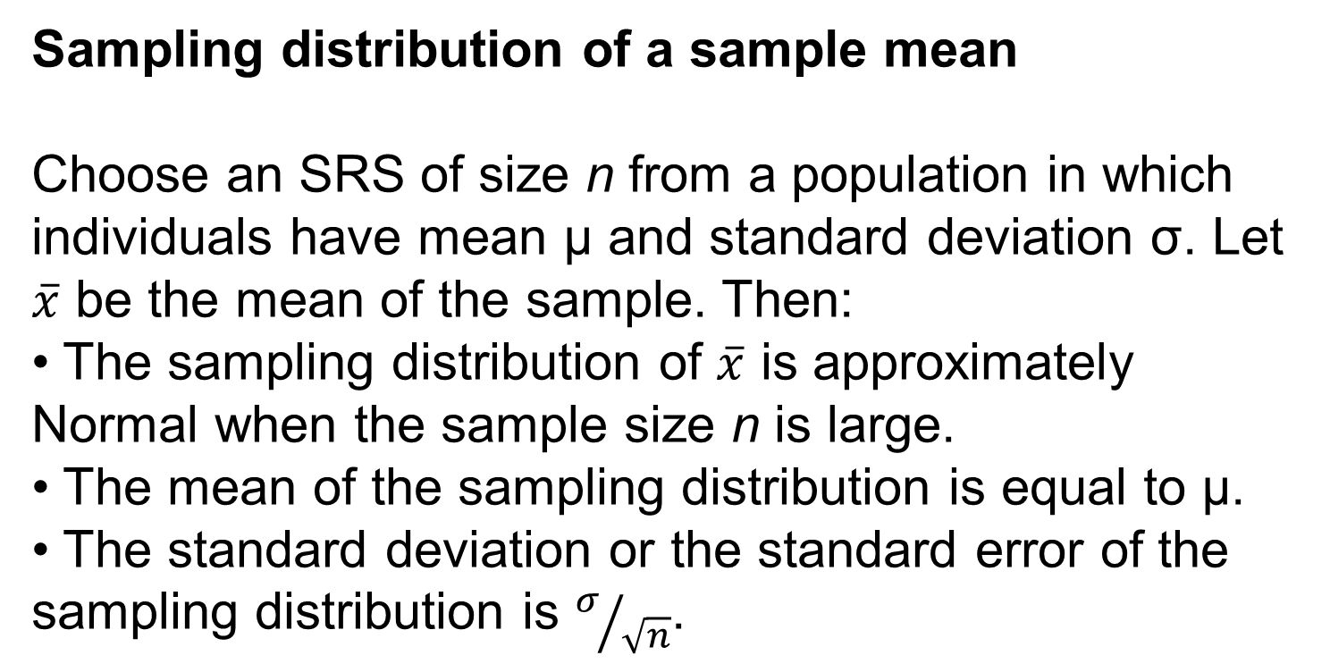
The Sampling Distribution of a Sample Mean (optional) 3
Sampling distribution of a sample mean
Choose an SRS of size n from a population in which individuals have mean µ and standard deviation σ. Let $\overline{x}$ be the mean of the sample. Then:
• The sampling distribution of $\overline{x}$ is approximately Normal when the sample size n is large.
• The mean of the sampling distribution is equal to µ.
• The standard deviation or the standard error of the sampling distribution is $σ/{\sqrt{n}}$.

Slide 39
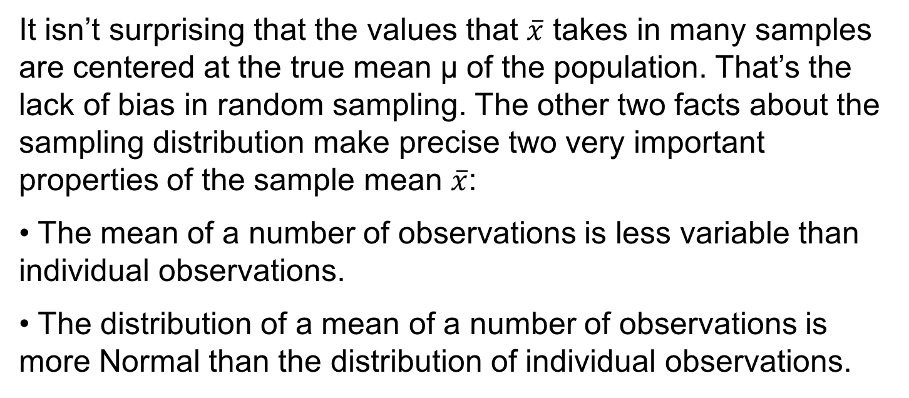
The Sampling Distribution of a Sample Mean (optional) 4
It isn’t surprising that the values that $\overline{x}$ takes in many samples are centered at the true mean µ of the population. That’s the lack of bias in random sampling. The other two facts about the sampling distribution make precise two very important properties of the sample mean $\overline{x}$:
• The mean of a number of observations is less variable than individual observations.
• The distribution of a mean of a number of observations is more Normal than the distribution of individual observations.

Slide 40
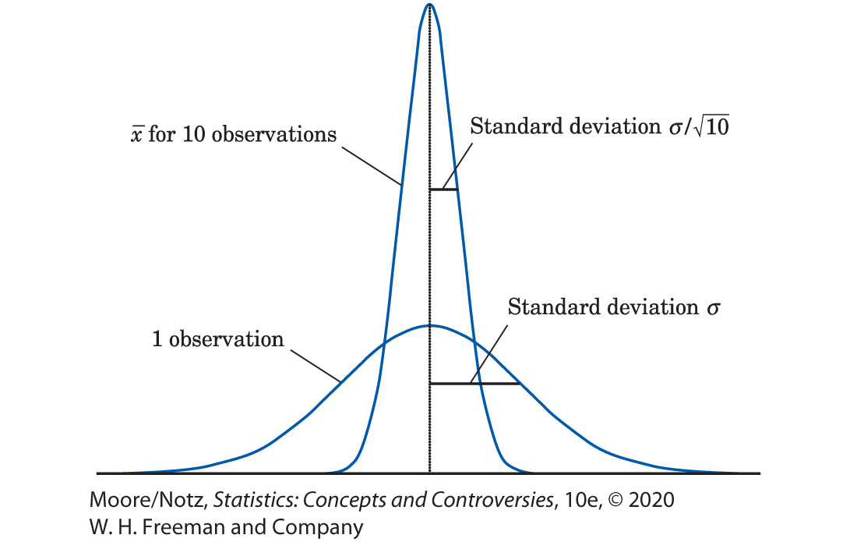
The Sampling Distribution of a Sample Mean (optional) 5

Slide 41
The Sampling Distribution of a Sample Mean (optional) 6
Figure 21.7 illustrates the first of these properties.
It compares the distribution of a single observation with the distribution of the mean of 10 observations.
Both have the same center, but the distribution of the sample mean is less spread out.

Slide 42
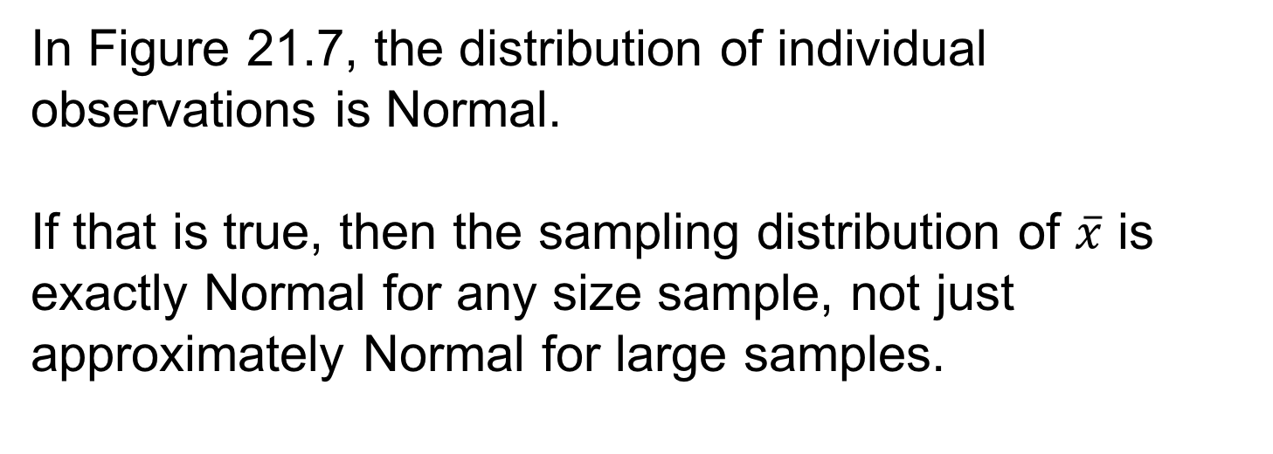
The Sampling Distribution of a Sample Mean (optional) 7
In Figure 21.7, the distribution of individual observations is Normal.
If that is true, then the sampling distribution of $\overline{x}$ is exactly Normal for any size sample, not just approximately Normal for large samples.

Slide 43
The Sampling Distribution of a Sample Mean (optional) 8
A remarkable statistical fact, called the central limit theorem, says that as we take more and more observations at random from any population, the distribution of the mean of these observations eventually gets close to a Normal distribution.
There are some technical qualifications to this big fact, but, in practice, we can ignore them.
The central limit theorem lies behind the use of Normal sampling distributions for sample means.

Slide 44
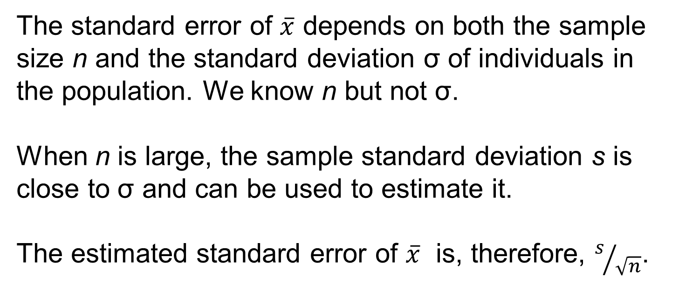
Confidence Intervals for the Population Mean (optional) 1
The standard error of $\overline{x}$ depends on both the sample size n and the standard deviation σ of individuals in the population. We know n but not σ.
When n is large, the sample standard deviation s is close to σ and can be used to estimate it.
The estimated standard error of $\overline{x}$ is, therefore, $s/{\sqrt{n}}$.

Slide 45
Confidence Intervals for the Population Mean* (optional) 2
Now we can find confidence intervals for µ following the same reasoning that led us to confidence intervals for a proportion p.
The big idea is that to cover the central area C under a Normal curve, we must go out a distance z* on either side of the mean.

Slide 46
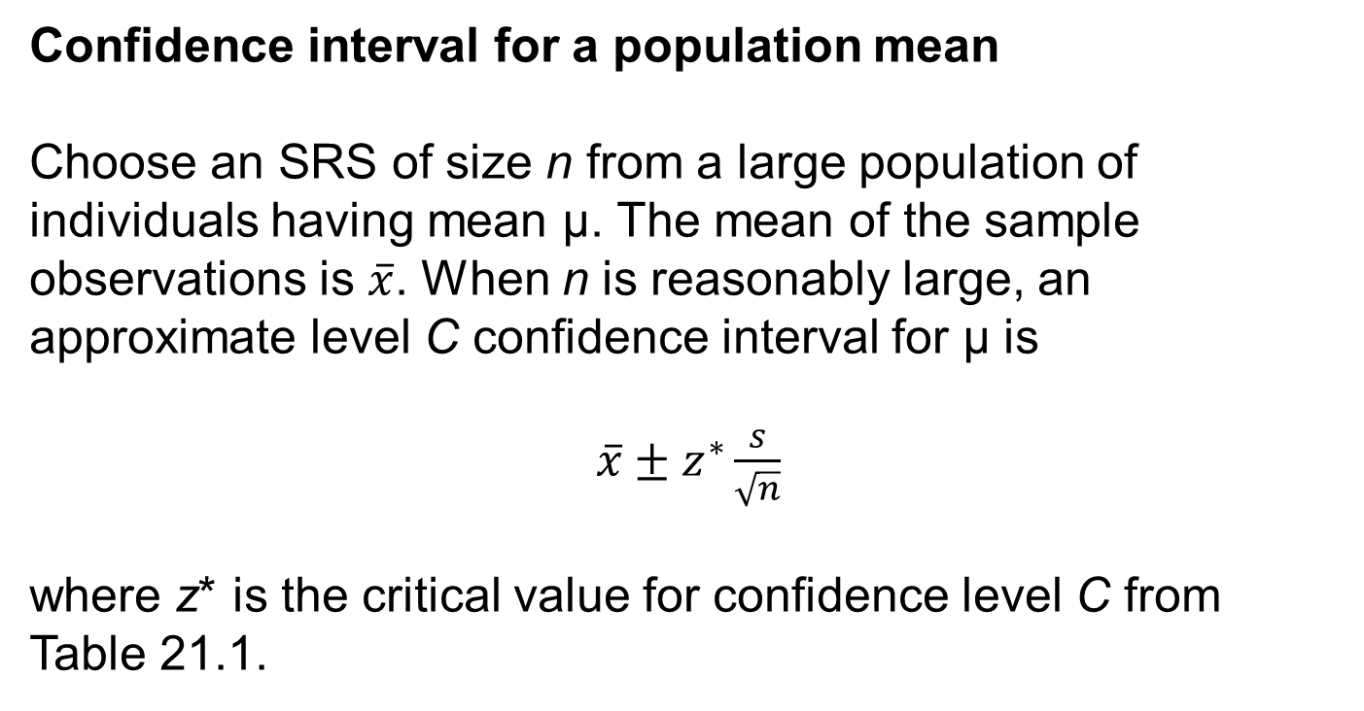
Confidence Intervals for the Population Mean (optional) 3
Confidence interval for a population mean
Choose an SRS of size n from a large population of individuals having mean µ. The mean of the sample observations is $\overline{x}$. When n is reasonably large, an approximate level C confidence interval for µ is
$\overline{x}±z^{∗}\frac{s}{\sqrt{n}}$
where z* is the critical value for confidence level C from Table 21.1.

Slide 47
Confidence Intervals for the Population Mean (optional) 4
The recipe is valid only when an SRS is drawn and the sample size n is reasonably large.
How large is reasonably large? The answer depends upon the true shape of the population distribution.
n ≥ 15 is usually adequate unless there are extreme outliers or strong skewness.
For clearly skewed distributions, a sample size of n ≥ 40 often suffices if there are no outliers.

Slide 48
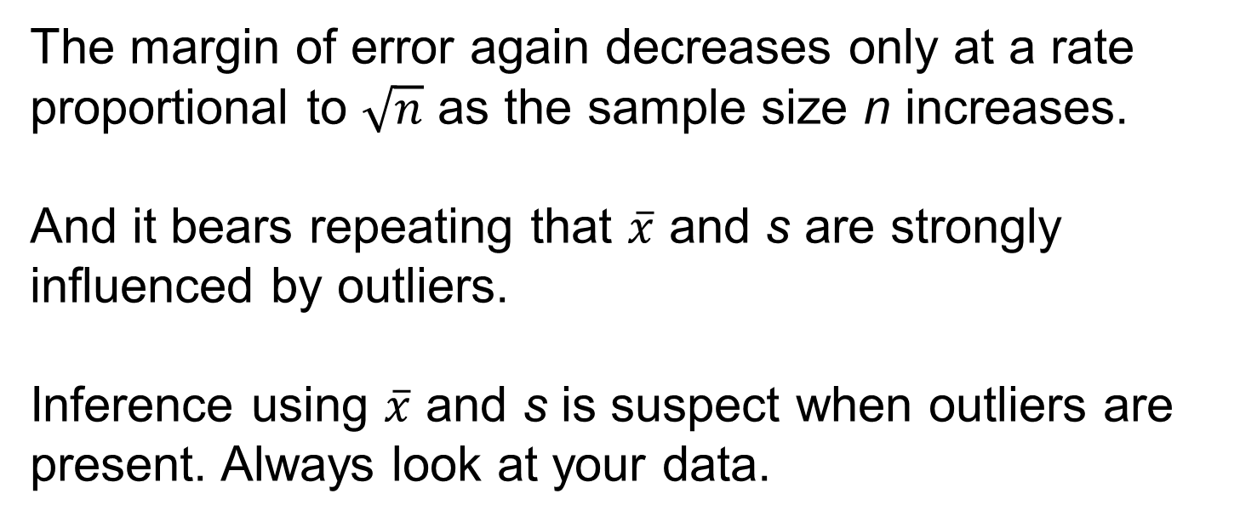
Confidence Intervals for the Population Mean (optional) 5
The margin of error again decreases only at a rate proportional to $\sqrt{n}$ as the sample size n increases.
And it bears repeating that $\overline{x}$ and s are strongly influenced by outliers.
Inference using $\overline{x}$ and s is suspect when outliers are present. Always look at your data.

Slide 49
Statistics in Summary 1
A confidence interval estimates an unknown parameter in a way that tells us how uncertain the estimate is. The interval itself says how closely we can pin down the unknown parameter. The confidence level is a probability that says how often in many samples the method would produce an interval that does catch the parameter. We find confidence intervals starting from the sampling distribution of a statistic, which shows how the statistic varies in repeated sampling.

Slide 50
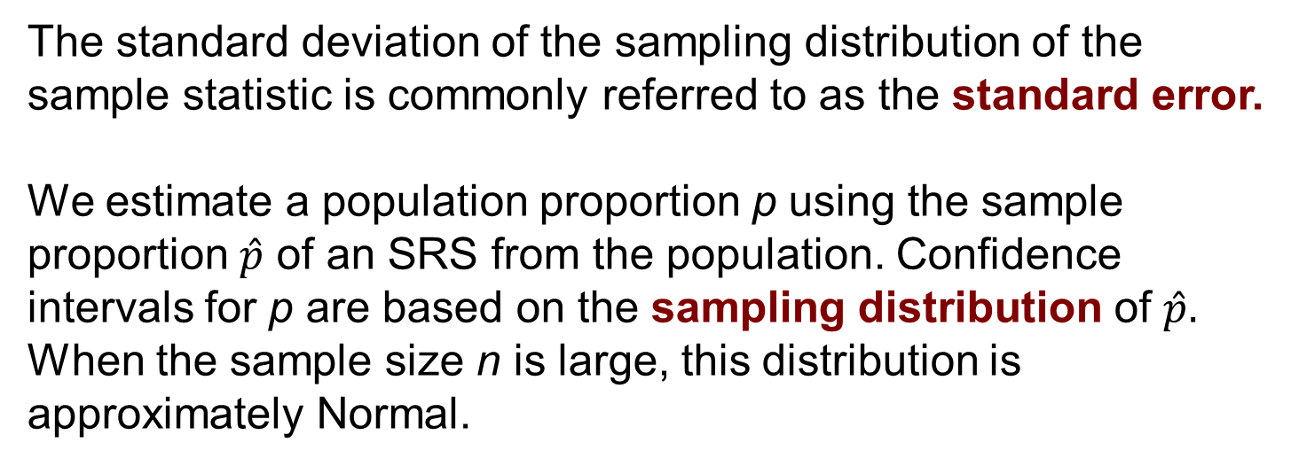
Statistics in Summary 2
The standard deviation of the sampling distribution of the sample statistic is commonly referred to as the standard error.
We estimate a population proportion p using the sample proportion $\hat{p}$ of an SRS from the population. Confidence intervals for p are based on the sampling distribution of $\hat{p}.$ When the sample size n is large, this distribution is approximately Normal.

Slide 51
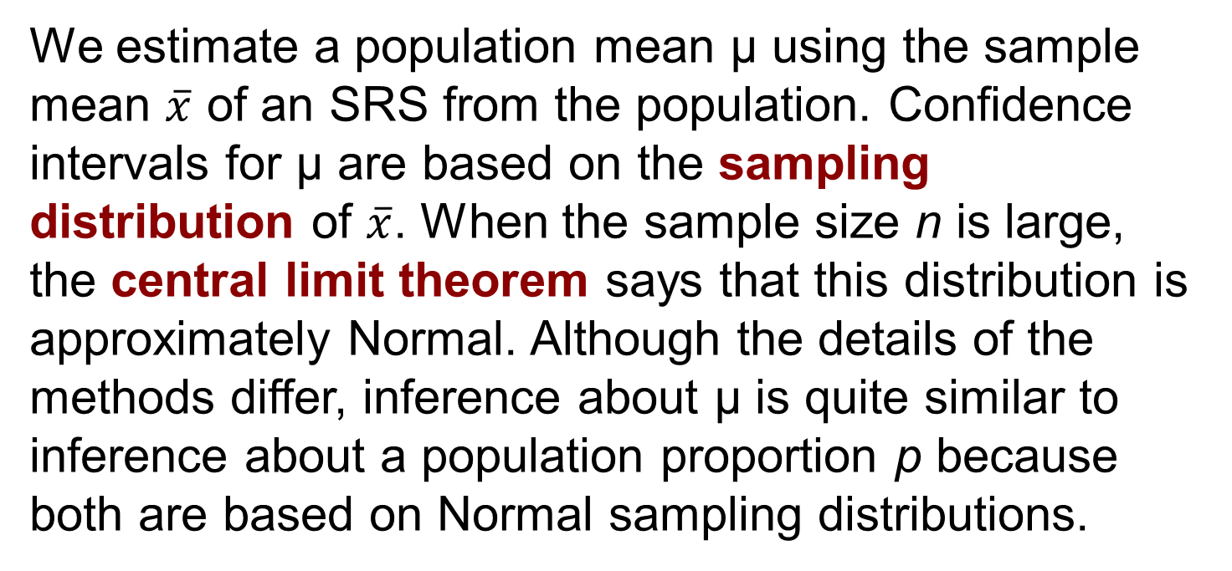
Statistics in Summary 3
We estimate a population mean µ using the sample mean $\overline{x}$ of an SRS from the population. Confidence intervals for µ are based on the sampling distribution of $\overline{x}$. When the sample size n is large, the central limit theorem says that this distribution is approximately Normal. Although the details of the methods differ, inference about µ is quite similar to inference about a population proportion p because both are based on Normal sampling distributions.

